Slide 1

Core Product Architecture
Configurable Microservice Architecture
Web Portals
API
Extensions
Studio
Cloud Automation
Cloud Watch
Cloud Automation
Scheduler
Notifications
REST
IaaS Connectors
Notifications
HTTPS
HTTPS
Resource Manager
Catalog
GraphQL
Catalog
TCP
TCP
Agents
Core
Resource Control
IAM
TCP
Relational Database
Monitoring
TCP
Scheduler
Node
Resource Manager
ProActive Actor Model
Stateless Replication Set with Load Balancer
Active/Passive Replication Set with Load Balancer

Slide 2







Core
Product
Processing & Automation Workflows
Scheduling & Orchestration
Highly Expressive workflows
Flexible structures with conditional branches, loops, tasks replications and composition
Advanced error management policies for hardware and software issues with automatic and manual recovering procedures
Scheduling with flexible priority management
FIFO policy with priorities (extensible via a plugin)
Change priority during execution
Support for preemptive policies
Workflows
Scheduler
Polyglot workflows writing tasks in major scripting languages
Support for bash, cmd, python, javascript, ruby, groovy, java, perl, R (powershell coming soon)
Exchange variables between different languages
Modern Identity and Access Management
Pluggable to enterprise directories (AD, LDAP)
Define users and group
Modern access control definition with IAM policies
Multi-language
IAM
Repository for all ProActive objects
Workflow definitions, job planning definitions, etc.
Simple object-store model with meta-data and versioning
Objects are organized in buckets
Keep notified via email, webhooks & webui
Automatic email notifications on events (job termination, task failure, etc.)
Web hooks for integration with 3rd party services
Notification for manual validation process
Catalog
Notifications
Seamless data transfers between tasks
Automatic selection for file transfer protocol
3 scopes: scratchspace, userspace, globalspace
Planning tool for recurring executions:
Simple rules with legacy cron expression
Advanced definitions with exclusion calendars (holidays) and inclusion calendars (maintenances)
Dataspaces
Job Planner

Slide 3





Core
Product
Resource Management & Monitoring
Interfaces
Integrated resource management
Flexible structures with conditional branches, loops, tasks replications and composition
Advanced error management policies for hardware and software issues with automatic and manual recovering procedures
Integrated web interfaces
Studio for workflow design
Scheduler for job administration
Resource Manager for infrastructure management
Notifications portal for notifications and validations
Resource Manager
Web Portals
Agents for advanced control and monitoring
Cross-platform: Windows, Linux, MacOS
Resource Control: CPU, Memory, Storage
Resource Planning with Timeslots
Monitoring from hardware to user defined software metrics
Easy integration with 3rd party services
RESTful API
GraphQL API for bulk operations and manipulation of many objects
Java SDK
Agent
API
Software router
Support for multi-site deployments with firewalls and advanced security constraints
Secured with SSL
Facultative
Command Line Interface
Scriptable
Compatible with Linux and Windows
ProActive Router
CLI

Slide 4

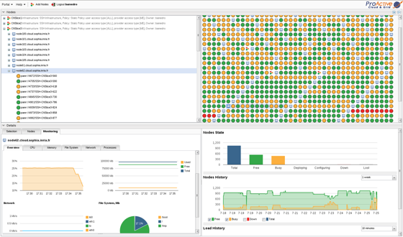











Cloud Automation Module
Automation in the Clouds of both Workloads and Services
End-User Portal
Job Console
Resource Manager
Cloud Automation Service
ProActive Catalogs
Support for major Cloud vendors and Technologies
Service Lifecycle Manager
Error Management
Application
Service
Lifecycle
ProActive Cloud Watch
ProActive Cloud Connectors
Monitoring
Complex Events Processing
Rules
Connector IaaS
Resource Control Policies

Slide 5
Cloud Automation Module
Cloud Automation Service
ProActive Cloud Watch
Flexible definition of lifecycle operations
No need to write complex full model description
Based on REST principles with CRUD operations
Operations are defined with ProActive workflows
Automatically trigger management procedures such as Disaster Recovery Procedure or Security Upgrades Procedure
Monitoring support JMX and simple file based probes
Complex Event Processing engine based on Drools
Standard Drools rules definition
Trigger any operation from an event or a correlation of events
Monitoring
Service Lifecycle Manager
CEP
Error Management
Rules
ProActive Catalogs
Cloud Connectors
Procedures to create applications or services, retrieve information, update the status of a service (restart, upgrade, reconfigure, etc.) or deletion are stored in ProActive Workflows
Simple and automatic mechanism to trigger the proper workflow execution according the the requested operation
Add a new operation just adding a workflow to the catalog
Integrated Cloud Connector service to operate Cloud platforms
Support for major public cloud platforms: Microsoft Azure, AWS, Google Cloud Platform, IBM Softlayer
Support for major private cloud technologies: VMWare, OpenStack, Microsoft Cloud Stack, Kubernetes, Docker Swarm
Advanced Resource Management policies with AutoScaling and OnDemand capabilities
Applications & Services
Connector IaaS
Lifecycle
Resource Control Policies

Slide 6

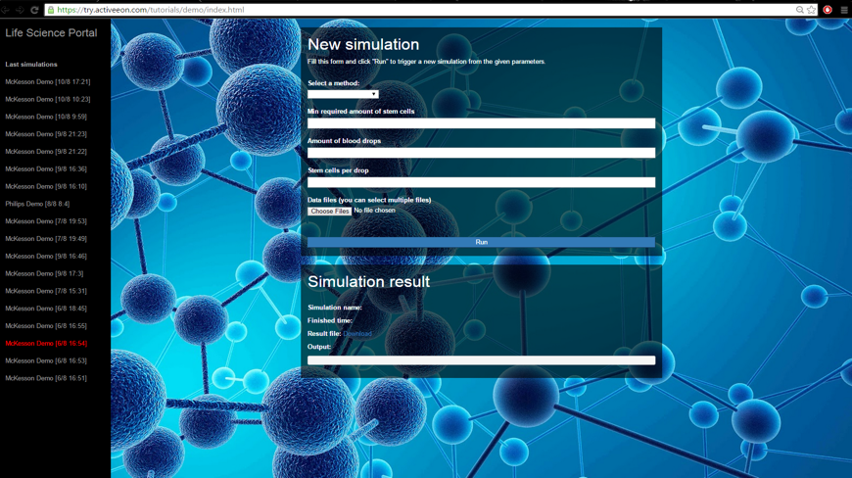






Big Data Automation Module
Deployment and Orchestration of Data Analytics
End-User Portal
Integrated Toolboxes
Specific Interfaces
Big Data Platforms
ProActive Toolboxes
Support for hybrid multi-paradigm processes: Batch, Streams, Data
Run hybrid computing platforms with Cloud Connectors integration
Support for many Big Data Platforms
Support scientific computing environments
Batchs
Streams
Data
Data Science
Numerical Computing
ProActive Cloud Watch
ProActive Cloud Connectors
Monitoring
Complex Events Processing
Rules
Connector IaaS
Resource Control Policies

Slide 7

Big Data Automation Module
Big Data Platforms
ProActive Cloud Watch
Run multidisciplinary workflows with seamless data transfers
Smart integration between platforms needs and automatic resource management
On Demand deployment for Hadoop, Spark, Storm and TensorFlow
Support for workload deployment on Tibco Sportfire, Hadoop, Spark, Greenplum SAS, TensorFlow, Storm
Monitoring support JMX and simple file based probes
Complex Event Processing engine based on Drools
Standard Drools rules definition
Trigger any operation from an event or a correlation of events
Batchs
Monitoring
Streams
CEP
Data
Rules
ProActive Toolboxes
Cloud Connectors
Support for R, Matlab and Scilab
ProActive specific functions available in supported environments
PASolve function with splitting strategy to parallelize computation for large matrix and vectors
Integration with ProActive Dataspaces for simple data transfers
Support for disconnected mode
Integrated Cloud Connector service to operate Cloud platforms
Support for major public cloud platforms: Microsoft Azure, AWS, Google Cloud Platform, IBM Softlayer
Support for major private cloud technologies: VMWare, OpenStack, Microsoft Cloud Stack, Kubernetes, Docker Swarm
Advanced Resource Management policies with AutoScaling and OnDemand capabilities
Data Science
Connector IaaS
Numerical Computing
Resource Control Policies

